Slide 1
MEDB 5510 Clinical Research Methods
Week 13
Data Analysis for Clinical Research
Notes:
Homework

Slide 2
Data Analysis
Project design and planning
Determine research hypotheses / questions
Study design
Measures – IV and DV
Test research hypotheses / questions
2

Slide 3
Data Analysis
Design Classification –
Between-Groups Designs
Each person “… is in one and only one condition or group.”
Within-Subjects (Repeated Measures) Designs
Each person “… receives or experiences all of the conditions or levels of the independent variable …”
Reason to use and not use Within-Subjects design?
3

Slide 4
Data Analysis
Design Classification –
Mixed Designs –
At least 1 Between-Groups IV
At least 1 Within-Subjects IV
4

Slide 5
Data Analysis
Design Considerations –
Number of IVs
Between-groups design?
Within-subjects design?
Mixed design?
Type of IVs
Active vs Attribute?
Between-groups vs Within-subjects?
Change over time
5

Slide 6
Data Analysis
Examples –
One-Group Posttest-Only
NR E: X O
Posttest-Only Nonequivalent Groups
NR E: X O
NR C: ~X O
Pretest-Posttest Nonequivalent Comparison Group Design
NR E: O1 X O2
NR C: O1 ~X O2
6

Slide 7
Data Analysis
Examples –
Posttest-Only Control Group
R E: X O
R C: X O
Pretest-Posttest Control Group
R E: O1 X O2
R C: O1 ~X O2
7

Slide 8
Data Analysis
Examples –
Randomized Experimental Design with Matching
M R E: X O
M R C: ~X O
Randomized Experimental (Crossover) Design
R Order 1 X O1 ~X O2
R Order 2 ~X O1 X O2
8

Slide 9
Data Analysis
Diagramming Designs / Data Layout
Between Groups Designs - example
Control Female O
Control Male O
Treatment Female O
Treatment Male O
9

Slide 10
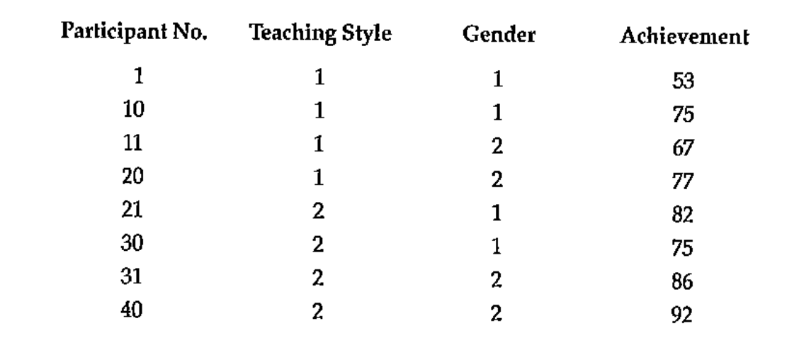
Data Analysis
Diagramming Designs / Data Layout
Between Groups Designs - example
10

Slide 11
Data Analysis
Diagramming Designs / Data Layout
Within-Subjects Designs – example
Pretest Posttest Pretest Posttest
Tx Tx Control Control
Mixed Designs
Group 1 Tx Pretest Posttest
Group 2 Control Pretest Posttest
11

Slide 12
Data Analysis
Labeling / Terminology
Single-Factor Designs
1 IV
Ex – single-factor design with 4 levels
Ex – single-factor repeated measures design with 4 levels
12

Slide 13
Data Analysis
Labeling / Terminology
Between-Groups Factorial Designs
More than 1 IV
“factorial” ➔ 2 or more IVs
List the # of levels for each factor
Ex. 3 IVs ➔ 2 x 3 x 2
# of groups of individuals needed for this design?
13

Slide 14
Data Analysis
Labeling / Terminology
Within-Subjects Factorial Designs
More than 1 IV
“factorial” ➔ 2 or more IVs
List the # of levels for each factor
Ex. 2 IVs ➔ 2 x 3
… 2 x 3 within-subjects design OR
… 2 x 3 factorial design with repeated measures on both factors
# of groups of individuals needed for this design?
# of data points needed from each individual?
14

Slide 15
Data Analysis
Labeling / Terminology
Mixed Designs
Have at least 1 between-groups IV and at least 1 within-subjects IV
Traditionally, list between-groups IV(s) before within-subjects IV(s)
Ex. 2 x 3 x 4 factorial design with repeated measures on the 3rd factor
# of groups of individuals needed for this design?
# of data points needed from each individual?
15

Slide 16
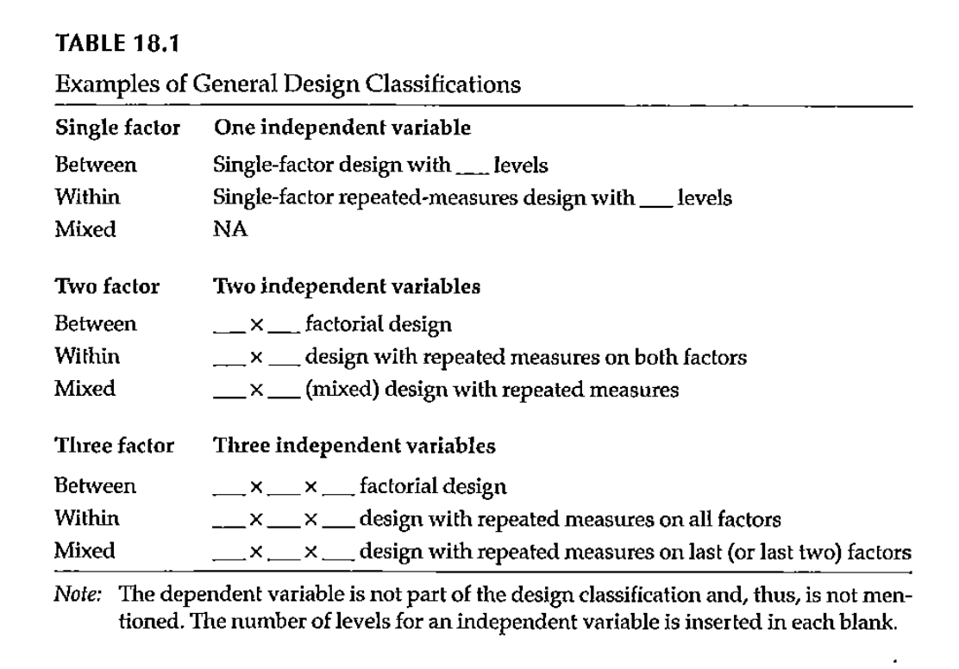
Data Analysis
Labeling / Terminology
16

Slide 17
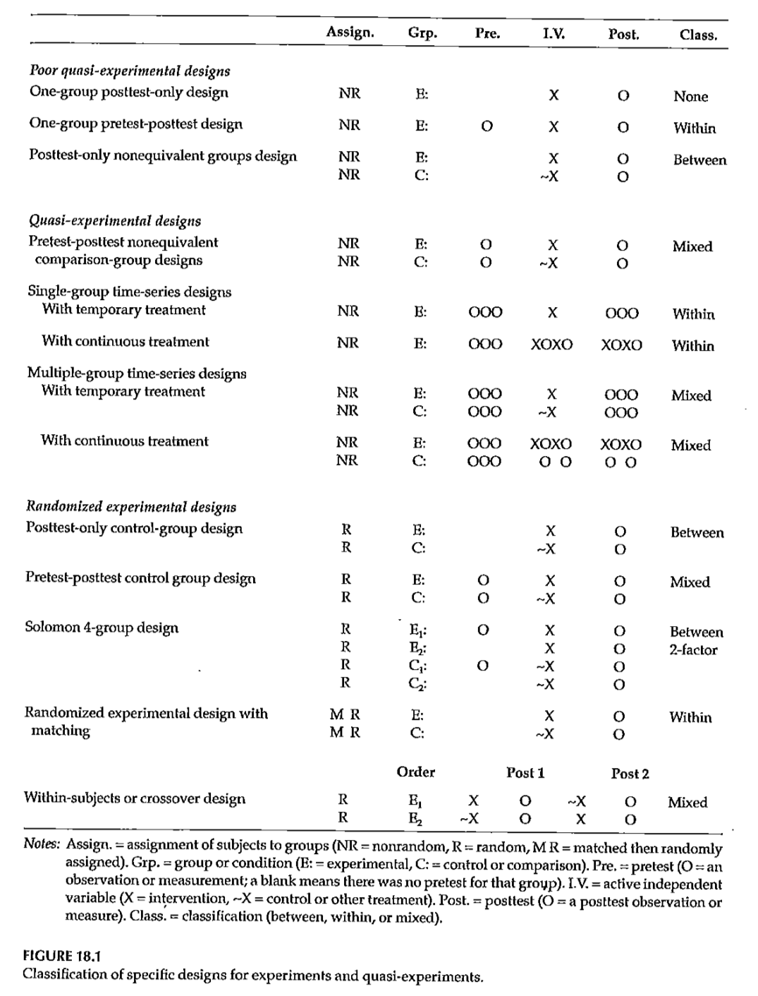
Data Analysis
17

Slide 18
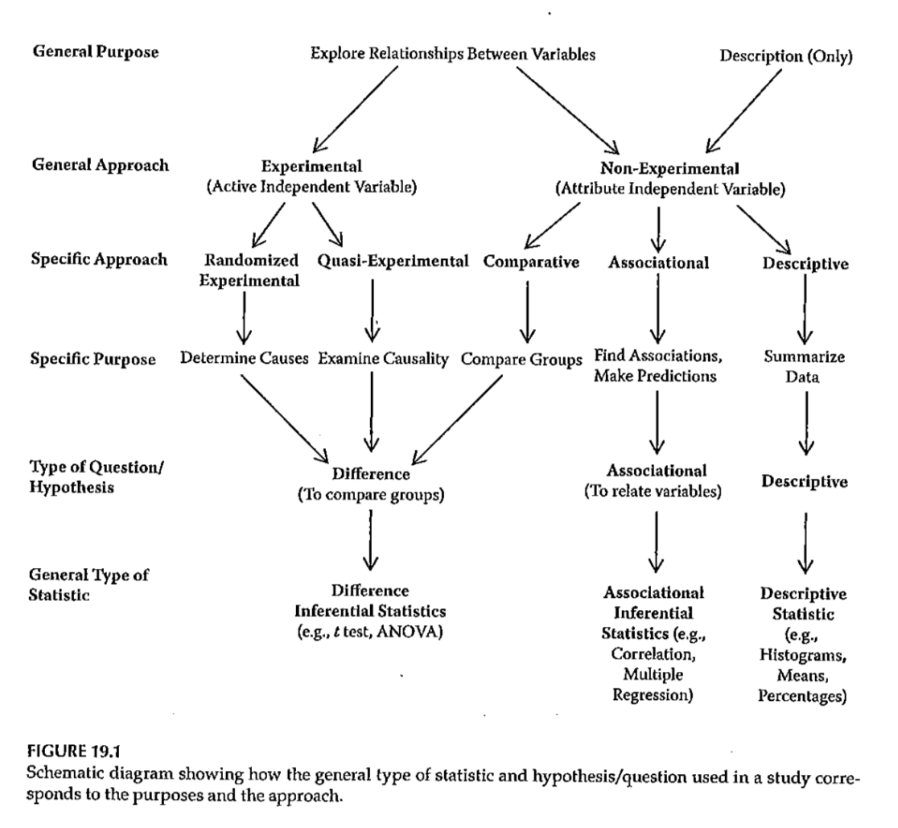
Statistical Analysis Selection
18

Slide 19
Statistical Analysis Selection
What are your research hypotheses / questions?
Difference?
Experimental, Quasi-experimental, or Comparative
Difference inferential statistics
Association?
Association (relation) between 2 or more variables
Associational inferential statistics
Descriptive?
19

Slide 20
Statistical Analysis Selection
Selecting statistical analysis method
Number of IVs
One IV or >1 IV?
Levels within the IVs
IV has few levels (2 – 4) – difference question
> 4 nominal levels – usually a difference question
> 4 ordinal levels – associational question
Measurement scale of the DV
Level of measurement
20

Slide 21
Statistical Analysis Selection
Selecting statistical analysis method
Design classifications –
Single-factor design
Between-Groups vs Within-Subjects
Factorial design (2 or more IVs)
Between-Groups vs Within-Subjects vs Mixed
21

Slide 22
Statistical Analysis Selection
Level of measurement
Normal
Highest level of measurement
Parametric statistics assume normal distribution
Ordinal
3 or more ordered levels
No assumption of normal distribution
Nominal
3 or more unordered levels
Dichotomous
Special case
Nominal, but can be used as if normally distributed
22

Slide 23
Statistical Analysis Selection
Level of measurement
Difference inferential statistical analysis
Level of measure for DV matters
Associational inferential statistical analysis
Need to consider level of measurement for all variables
23

Slide 24
Statistical Analysis Selection
Parametric statistics – assumptions
DV values come from a population of values that is normally distributed (normality)
Variances of the groups are equal (homogeneity of variance)
Unequal group sizes and unequal variances ➔ increased Type I errors
All participants with a particular group must be independent of each other (independence)
Also an assumption for nonparametric statistics
24

Slide 25
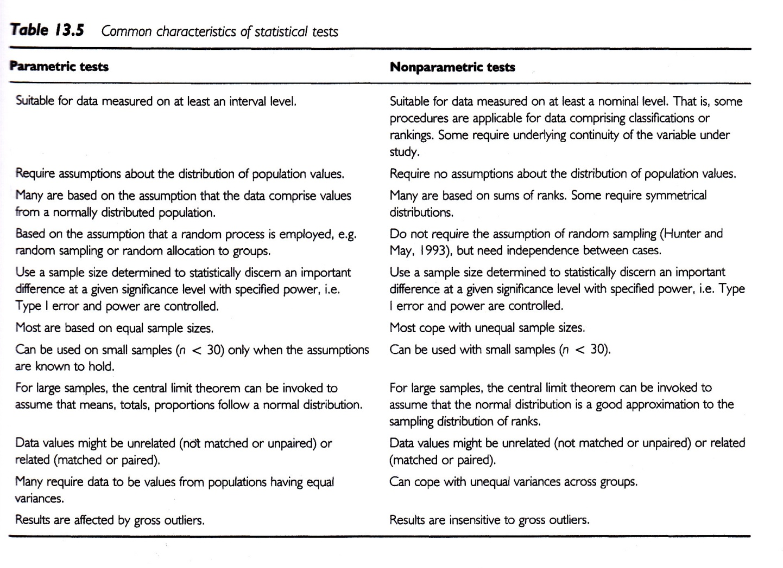
Statistical Analysis Selection
Parametric vs Nonparametric statistics
Sim & Wright, 2002
25

Slide 26
Statistical Analysis Selection
Selecting statistical analysis method –
RH/RQ – difference or association?
If IV has 2 – 4 levels – recommend difference approach
If IV has 5 or more ordered levels – recommend associational approach
If IV has 5 or more nominal (unordered) levels – usually difference approach
How many IVs?
26

Slide 27
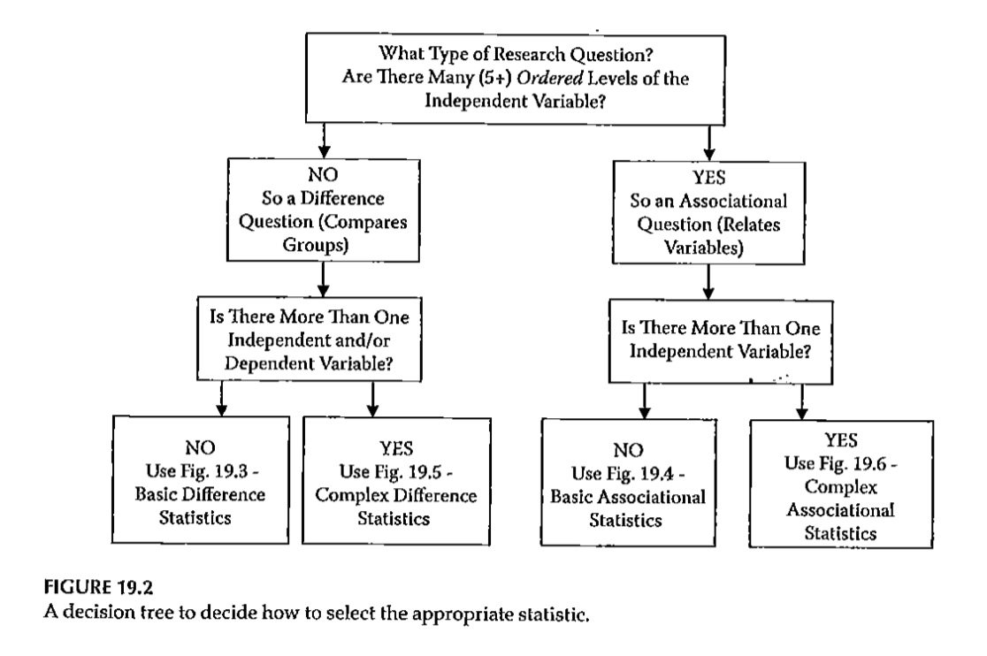
Statistical Analysis Selection
27

Slide 28
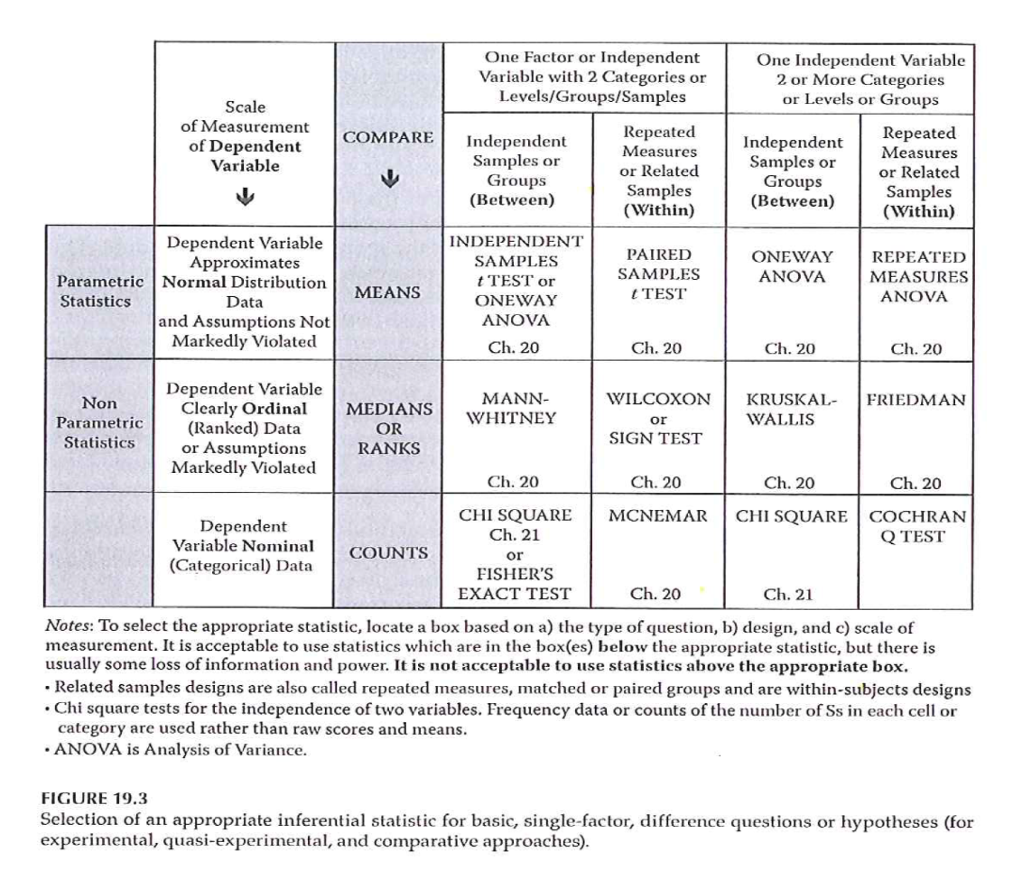
Statistical Analysis Selection
Fig 19.3 – Basic Difference
28

Slide 29
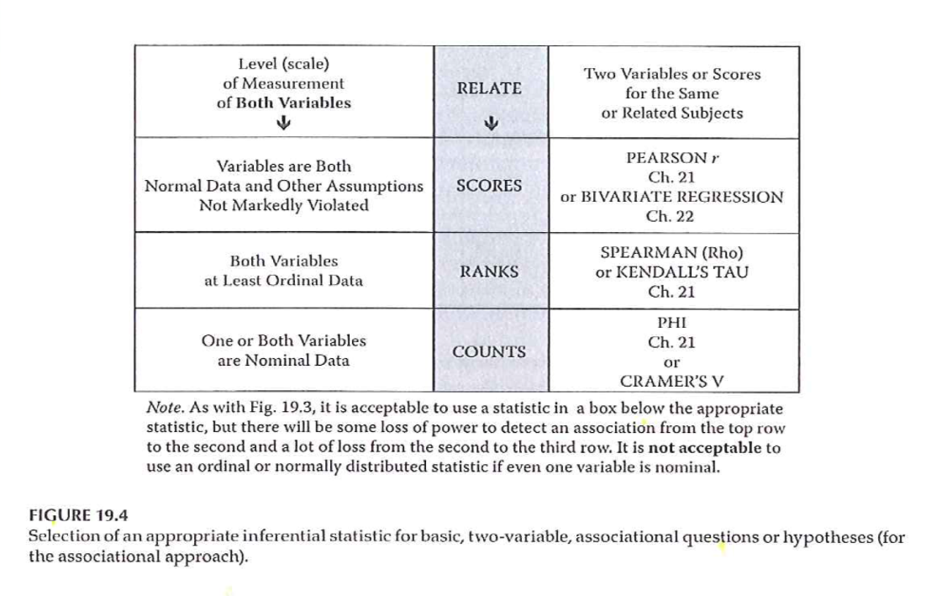
Statistical Analysis Selection
Fig 19.4 – Basic Associational
29

Slide 30
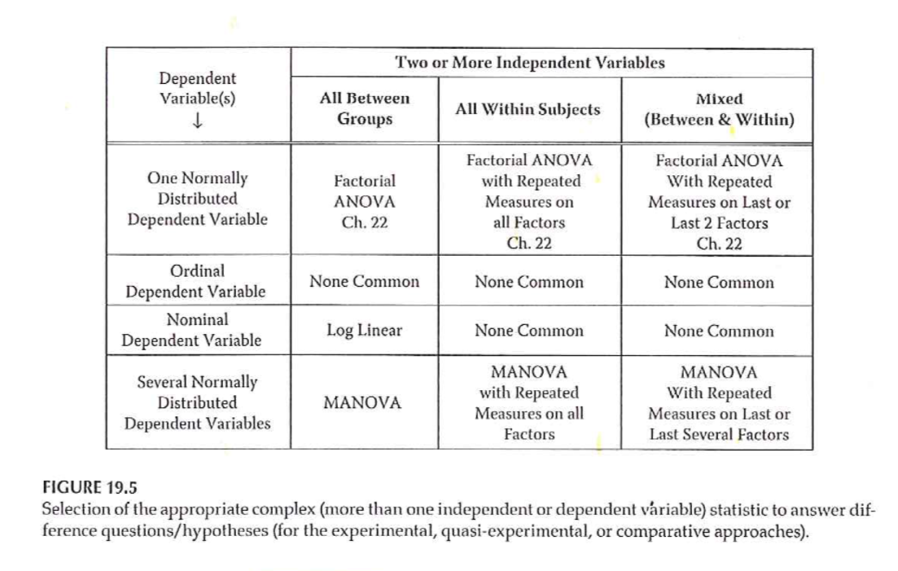
Statistical Analysis Selection
Fig 19.5 – Complex Difference
30

Slide 31
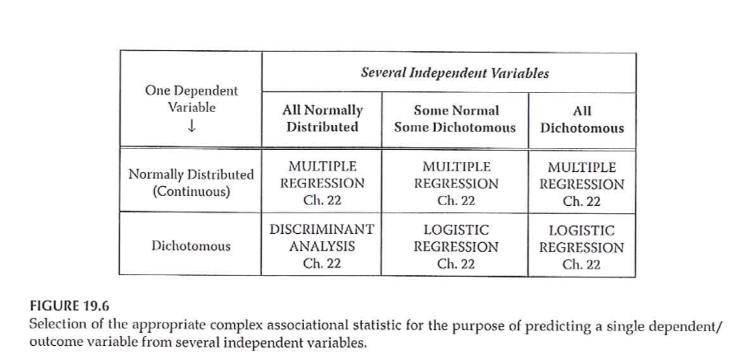
Statistical Analysis Selection
Fig 19.6 – Complex Associational
31

Slide 32
Data Analysis
What do you need to accomplish with your data analysis?
Quality check of data
Description of sample
Test of hypotheses/research questions
Additional exploratory analyses
32

Slide 33
Data Analysis
Quality check of data
Completeness of data collection
Review for responses that are ambiguous, out of range, etc
“Edit” responses as needed
Check response frequencies
Discover need for recoding
Scale of measurement
Check subscale coding and scores
Check inter-item reliability
33

Slide 34
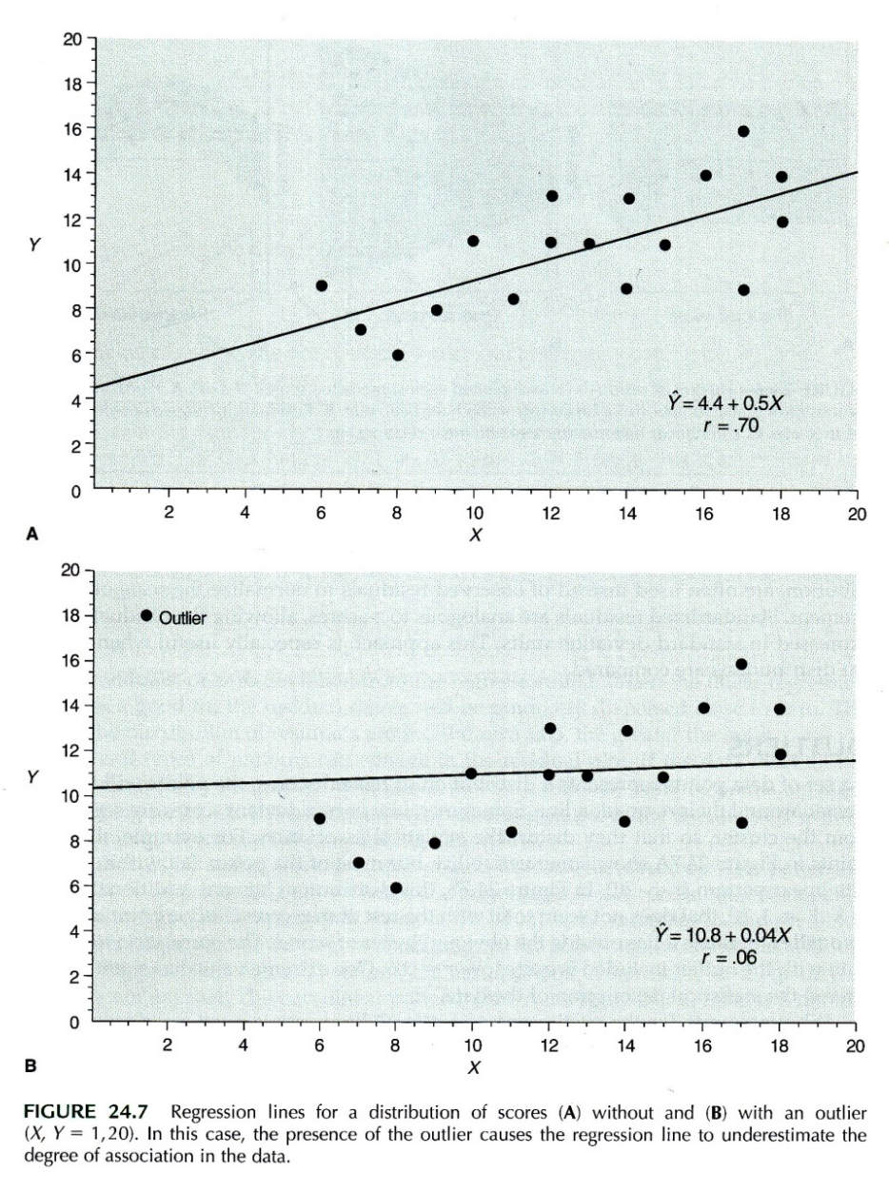
Data Analysis
Portney & Watkins, 2009
34
Predicting an
outcome measure

Slide 35
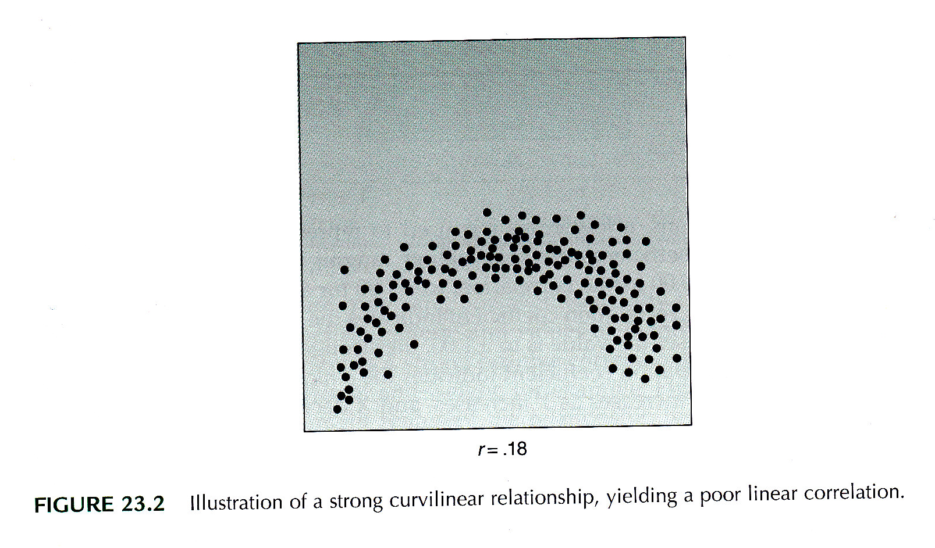
Data Analysis
Correlations
Portney & Watkins, 2009
35

Slide 36
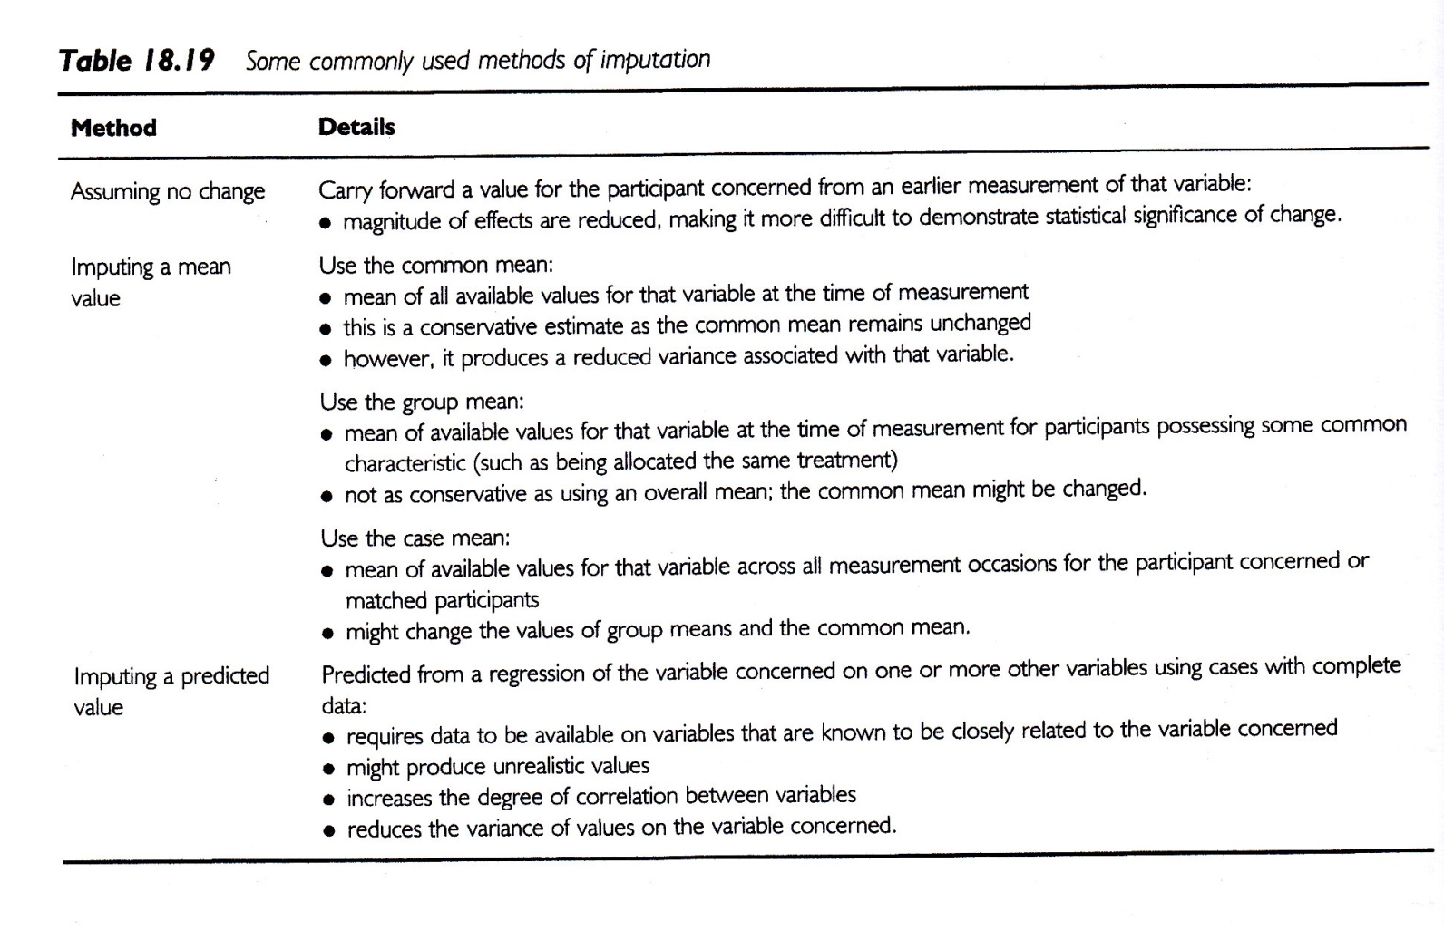
Data Analysis
Handling missing data
Sim & Wright, 2002
36

Slide 37
Data Analysis
Description of sample
Usually the first table in a manuscript
What is relevant to be included?
How should it be represented?
37

Slide 38
Data Analysis
Test of hypotheses/research questions
Testing relationships
Comparing groups
How many groups?
What kind of outcome measure?
Predicting an outcome measure
Nonparametric tests for group comparisons
Comparison of categorical variables
38

Slide 39
Data Analysis
39
Additional, exploratory analyses
What results to follow-up on and explore?
How to interpret these?

Slide 40
Assignment #10
Expand the “outline” for your research proposal to include information on the data analysis that will be needed for your proposed study. In addition to a description of the steps that are planned for preliminary data review (e.g., check distribution of measures, check item reliability of scales), the outline should consist of a description of analyses that are planned to address each research hypothesis/question.

